Slide 1
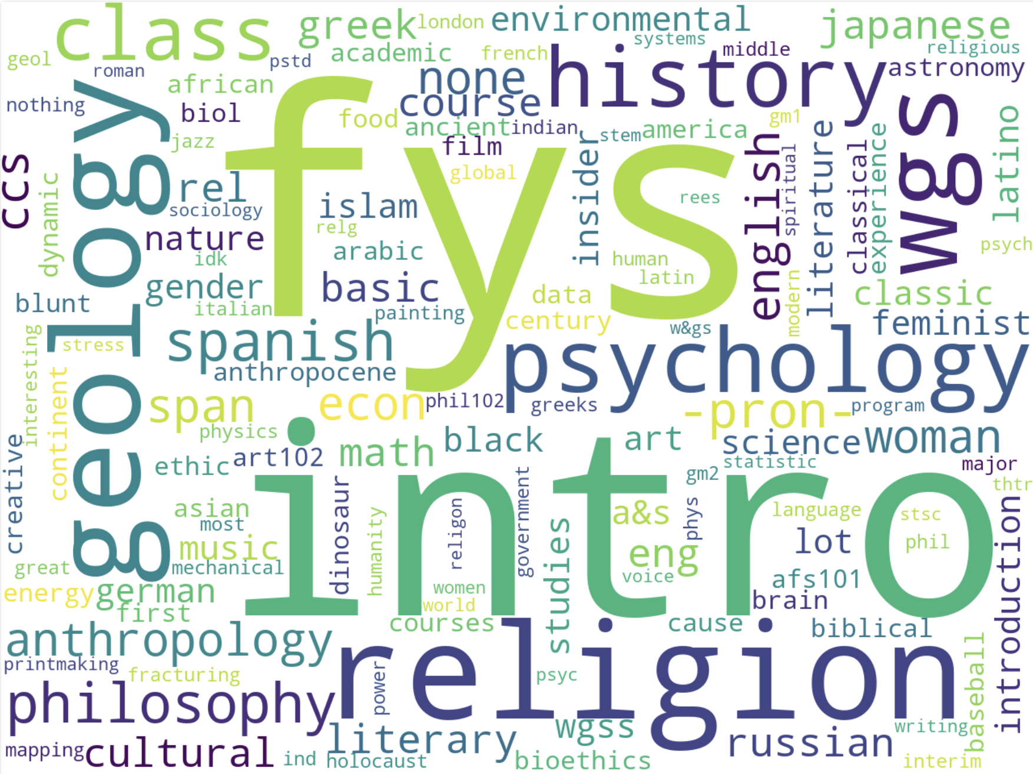
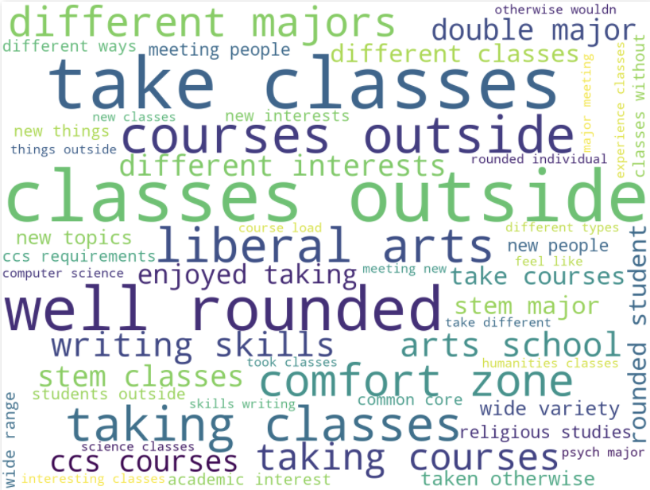
Findings of the Common Course of Study Review
September 2019 - December 2020
(Updated January 2021)
Word cloud: Jason Simms via distantReader

Slide 2
Table of Contents
Thank You to the Lafayette Community (Slide 3)
Surveys on the Perception of the Current CCS
Faculty (Slide 4)
Students (Slide 5)
Data from the Office of Institutional Research and the Registrar’s Office (Slides 6-14)
Focused Conversations (Slides 15-30)
Comparison Schools (Slides 31-33)
Open Meeting Notes (Slides 34-35)
Comments? Questions? (Slide 36)

Slide 3
Thank You!
The CCS Review Steering Committee would like to thank the many students, faculty, and staff who helped conducting a thorough review of our Common Course of Study, including representatives or members of:
606 students and 129 faculty who participated in the CCS surveys.
Arts Advisory Committee
Campus Life Division
College Writing Program
Communications Division
Curriculum and Educational Policy Committee 2019/20 and 2020/21
"Dear Lafayette College" Group
Department of Foreign Languages and Literatures
First-Generation students
First-Year Seminar Program
Information Technology Services
International Students
Office of Advising
Office of Institutional Research
Office of Intercultural Development
Posse Students
Skillman Library
Student Athletes
Student Government & Student Academic Affairs Committee
Registrar's Office
Women's, Gender, and Sexuality Studies Program
.

Slide 4
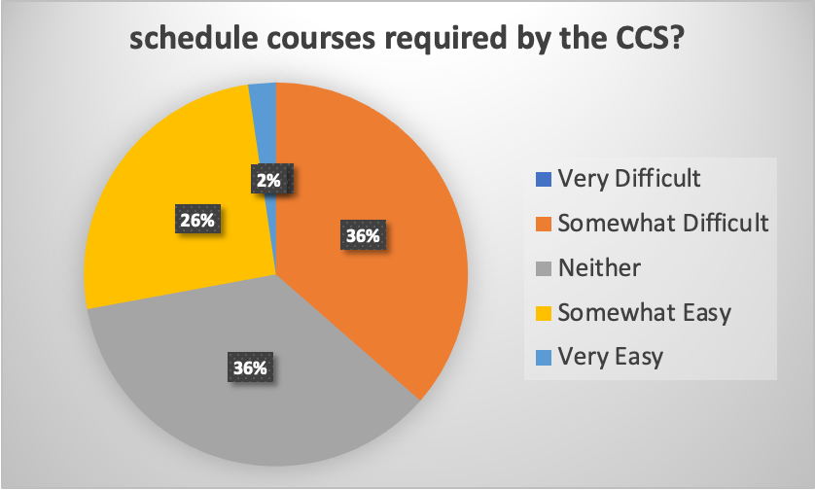
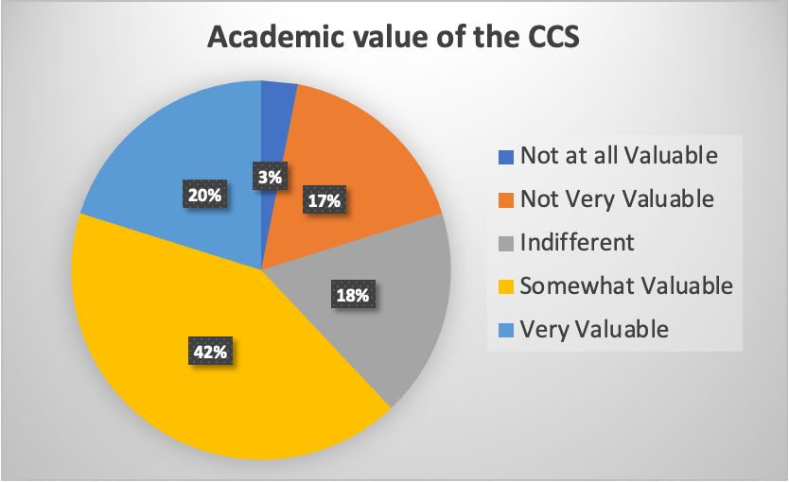
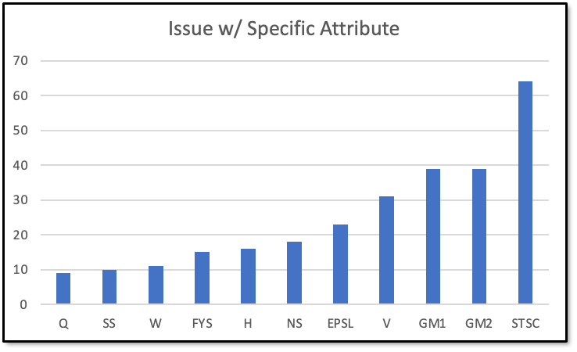
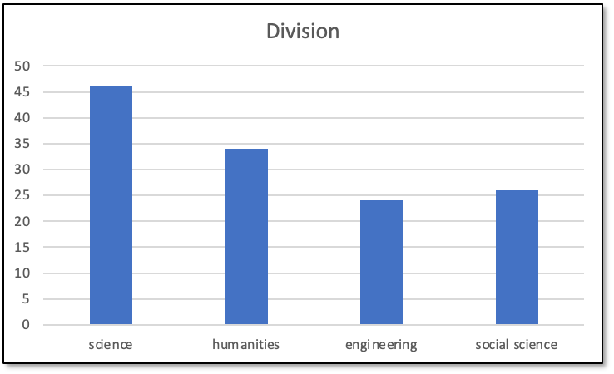
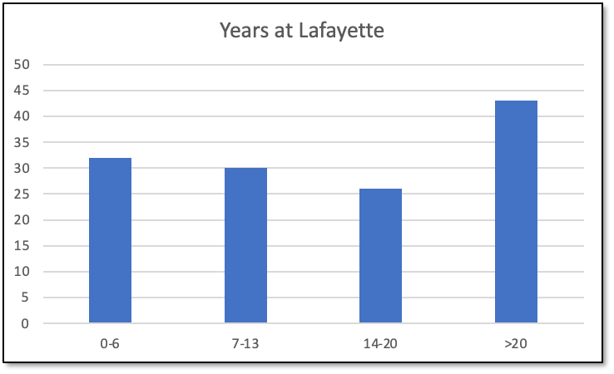
Faculty Survey
Jan 17 - Feb 2, 2020 (N_{max} = 129)

Slide 5
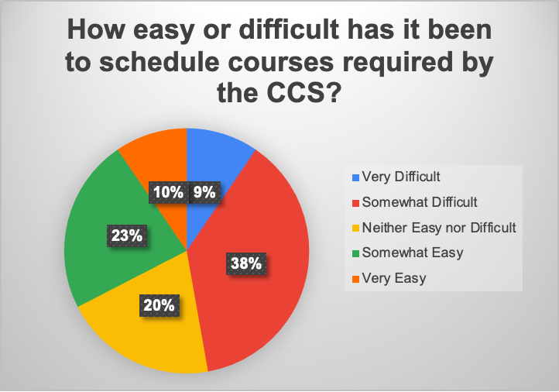
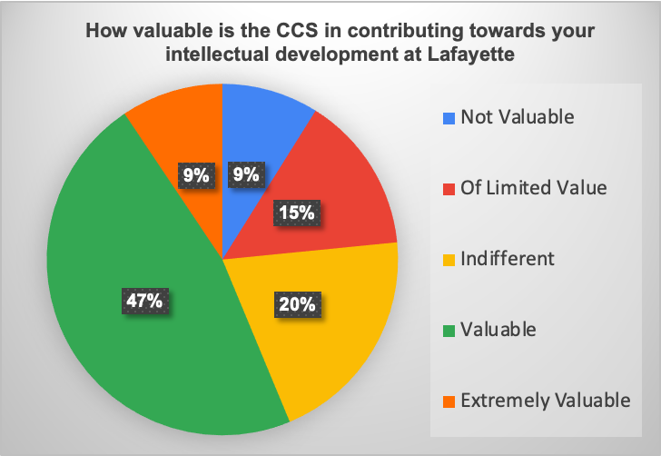
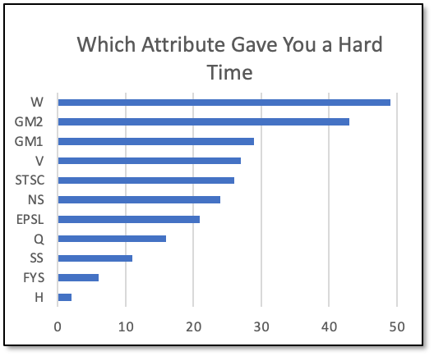
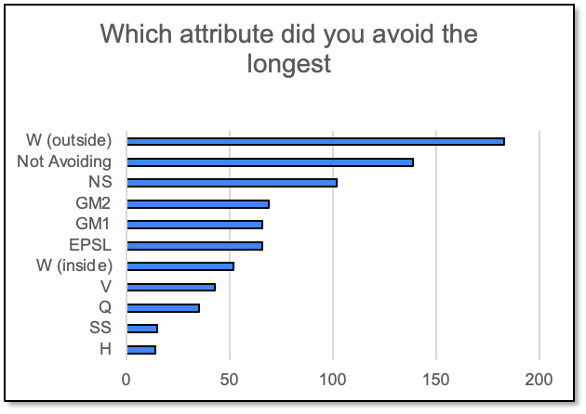
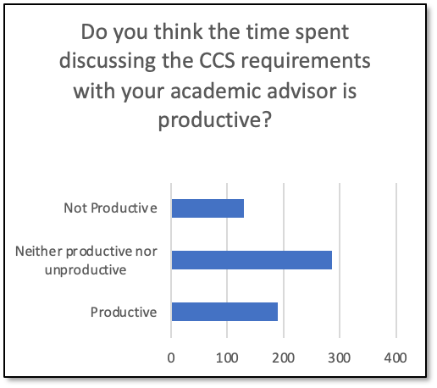
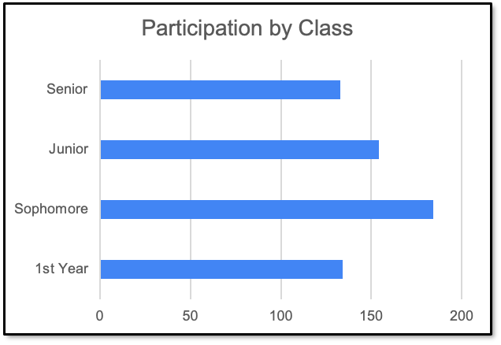
Student Survey
Jan 27 - Feb 9, 2020 (N_{max} = 606)
“Did you change your major or add a second major or add a minor because of a class (or classes) you took to fulfill a CCS requirement?”
Yes: 144 (~25%) No: 438 (~75%)

Slide 6
Data from the Office of Institutional
Research and the Registrar’s Office
For most attributes, 50-80% of students have completed the requirement by the beginning of their junior year. The major exception to this is the NS2 requirement.
Cohorts represented graduation years 2016-2019.
How to Read the Following Graphs
The following graphs show the cumulative percentage of students by division major who have completed a particular requirement by term.
There are five terms in an academic year: Fall; Interim; Spring; Summer 1; Summer 2.
Each step indicates the term in which the students complete that attribute.
The fall semesters are numbered 1 = fall 1st year, 6 = fall sophomore year, 11 = fall junior year, 16 = fall senior year.

Slide 7
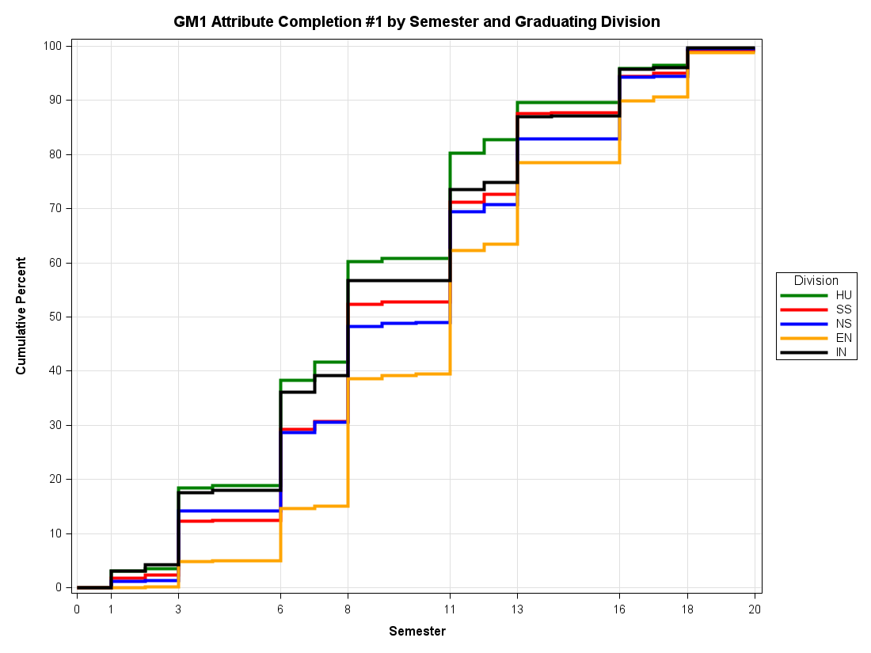
Completion of GM 1 by Major Division
1 = fall 1st year, 6 = fall sophomore year, 11 = fall junior year, 16 = fall senior year
By the fall semester of junior year, 60 to 80% of students have completed the GM 1 depending on major.
Engineering majors lag behind other majors mostly due to the limited number of electives they can take during the first two years.

Slide 8
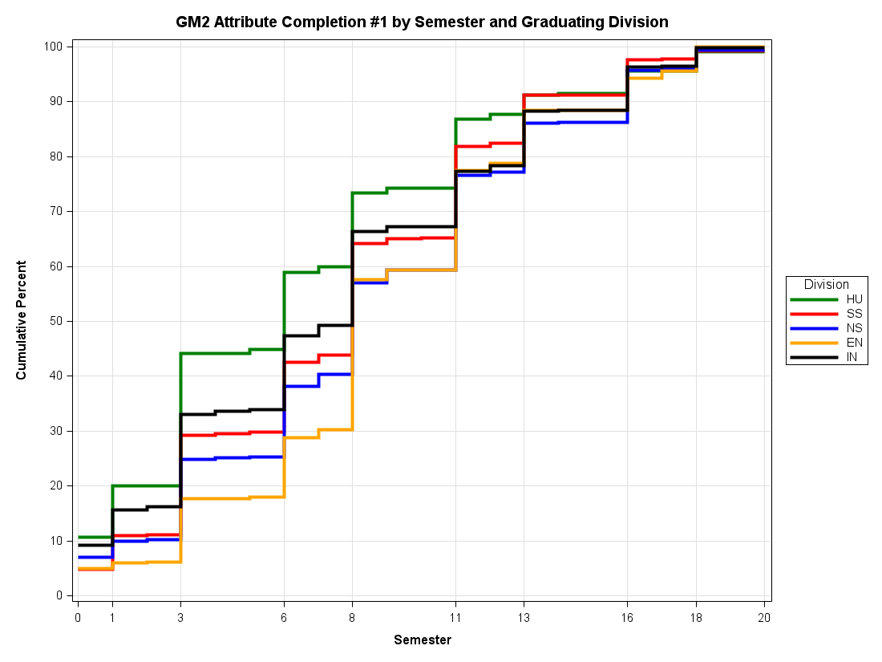
Completion of GM 2 by Major Division
1 = fall 1st year, 6 = fall sophomore year, 11 = fall junior year, 16 = fall senior year
Similar to GM 1, 60% to 80% of students finish the GM 2 requirement by fall semester of junior year.

Slide 9
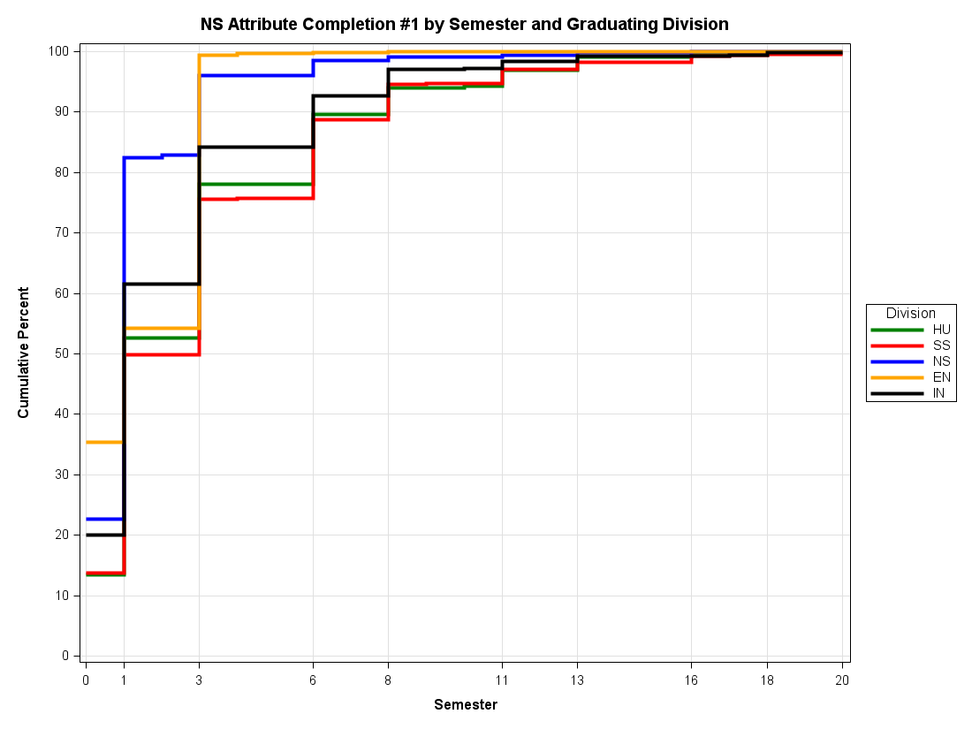
Completion of NS 1 by Major Division
1 = fall 1st year, 6 = fall sophomore year, 11 = fall junior year, 16 = fall senior year
For H and SS majors, almost 80% have fulfilled the NS 1 by the end of their first year and over 90% by the end of sophomore year.

Slide 10
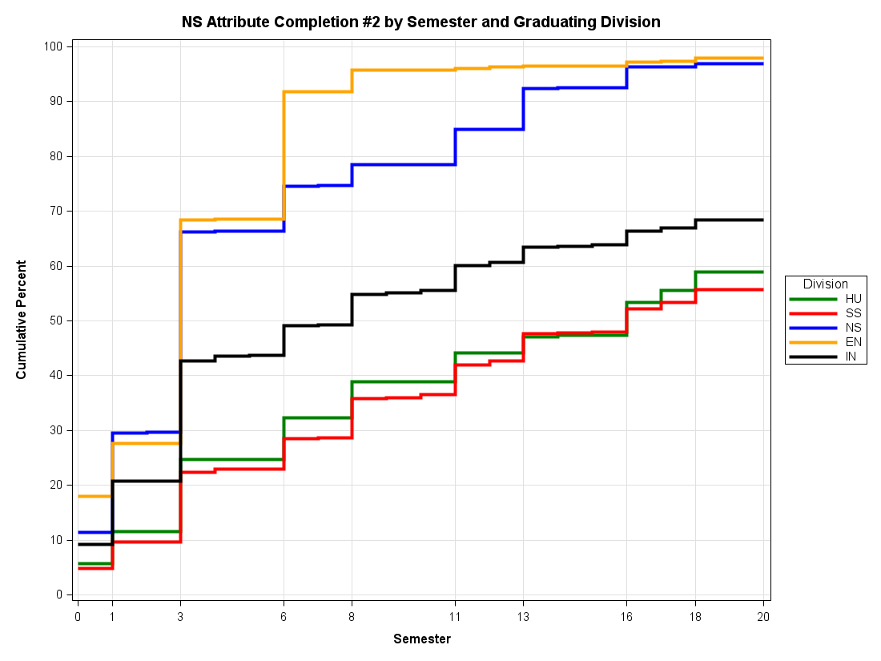
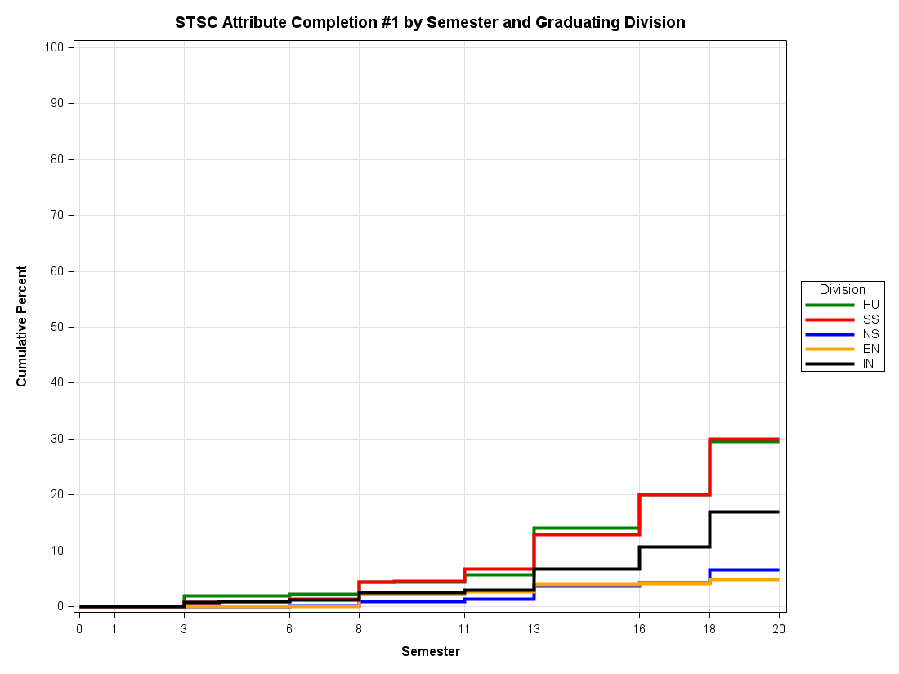
Completion of NS 2 or STSC by Major Division
1 = fall 1st year, 6 = fall sophomore year, 11 = fall junior year, 16 = fall senior year

Slide 11
Takeaways from NS 2 and STSC
SS and H majors delay taking a second NS course. Only 50% have taken the second course by the end of junior year.
The percentage of students taking a NS 2 rises to almost 60% by the senior year, but the remaining students take an STSC.
20% of H and SS majors have taken an STSC by the end of the fall semester of senior year.
This percentage rises to 30% by end of senior year.

Slide 12
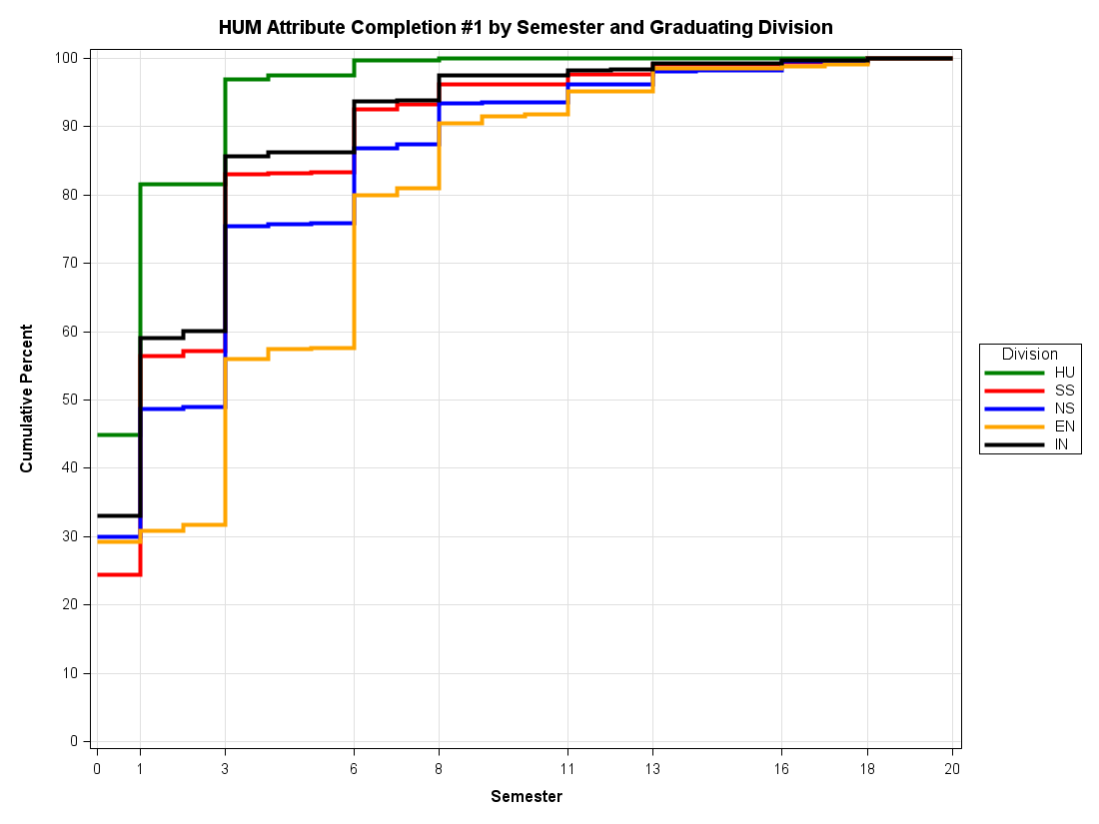
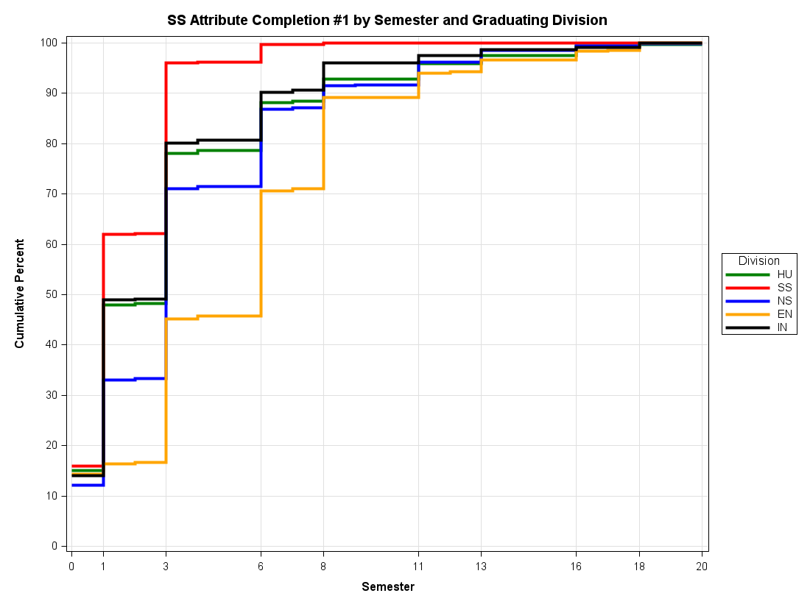
Completion of HUM and SS by Major Division
1 = fall 1st year, 6 = fall sophomore year, 11 = fall junior year, 16 = fall senior year

Slide 13
Takeaways from HUM and SS
NS and E majors take longer to complete these requirements.
SS is completed by 70% of E and 85% of NS majors by the end of the first semester of sophomore year.
HUM is completed by 80% of E and 85% of NS majors by the end of the first semester of sophomore year.

Slide 14
How Many Courses at Lafayette Have
Multiple Attributes?
Number of Attributes | Number of Courses* N=621
5 | 3
4 | 22
3 | 62
2 | 147
1 | 387
* Courses offered between Fall 2012 and Spring 2018
Note that courses that have 1 attribute include H,SS, etc. (divisional attributes).
25 courses across the sample have 4 or more attributes.

Slide 15
Focused Conversations
How to Read the Following Slides
The information on the slides is selective. Each slide only shows three issues that were prominent among a larger number of topics that were discussed. The Steering Committee has fuller notes from the meetings.
Critical remarks are overrepresented on these slides. Participants in the focus conversations had positive things to say about the CCS as well. But for the purpose of providing impulses for future discussion, more space has been allotted on the slides to possible areas of improvement in the CCS.
The observations and opinions reflected on the slides are those of the focus groups.

Slide 16
Focused Conversation: “Dear Lafayette College”
11/10/2020 M. Dubischar with F. Cham, T. Cook, M. Niles, S. Toure
Issues Raised
GM 1 and GM 2 are thematically too broad. Students can fulfill the GM requirements without ever seriously engaging with topics of diversity, equity, inclusion, and justice.
Students should learn about issues of diversity, equity, inclusion, and justice early during their time at Lafayette, ideally in the first semester.
More advisors should know their students more holistically as they advise them about the CCS and other academic matters. This is especially important for BIPOC students who are often required to bridge disconnected worlds when they transition to college.
.

Slide 17
Focused Conversation:
First-Generation Students
11/10/2020 M. Dubischar & N. Gil with K. Clark, R. Cox, D. Fertil, M. Deacon, S. Vaca
Issues Raised
The broad range of requirements can be seen both as a negative because some students feel like they take classes that don’t help with their major or grades, but also like a great positive because the CCS broadens the mind and exposes students to new academic areas that they may end up liking and pursuing further.
The number and scatteredness of CCS requirements can be overwhelming at first. Students can feel rushed early on because they fear they will fall behind on the CCS. In retrospect, this fear was unnecessary because completing the CCS is very doable. To navigate the CCS, students rely much more on DegreeWorks than on their academic advisors.
Depending on the major, it can be easier or more challenging to meet all CCS requirements. The distinction between GM 1 and GM 2 is confusing. There are not enough STSC offerings.

Slide 18
Focused Conversation:
International Students
3/5/2020 A. Brown & M. Dubischar with Students of the ISA Board
Issues Raised
The rules for placing out of the EPSL requirement for international students are not well communicated. More than few international students end up taking foreign language classes that are not required.
For 50+% of international students, writing in English is difficult, at least in the first couple semesters. FYS can therefore be particularly challenging. Could FYS be offered in the spring? A similar issue applies to W courses.
It is easier for American students to come to Lafayette with College credit. Therefore, international students have less freedom in their courses of choices.

Slide 19
Focused Conversation: Posse Students
10/5/2020 L. Malinconico & C. Sequin with Clennie Murphy, Keon Modeste, Basit Balogun, Flor De Maria Caceres
Issues Raised
Many students didn’t feel like they came in having a strong sense of what the CCS was and how to fulfill the requirements. They often relied on other Posse students to navigate these requirements and build their schedule. Some had little to no support from their advisors. They also expressed frustration with learning how to use DegreeAudit. This was also a reflection on this not being explained by their advisors.
Critiques of the CCS:
Difficulty to meet science requirement for students majoring in SS and humanities because of the schedule overlap of the lab with other courses. => science course was not their priority so they kept pushing it off. Perhaps a solution would be to offer more intro science courses that non majors could take.
More writing courses that are 100 or 200 levels as opposed to seminars, so it is easier for students to meet the W attribute outside of their major.
Suggestions for new CCS: sustainability, racial justice/social justice, professional readiness.

Slide 20
Focused Conversation: Student Athletes
10/28/2020 J. Smith & P. Cefalu with Four Student Athletes
Issues Raised
The difference between GM 1 and GM 2 is confusing.
Labs can be difficult to fit into schedules since they often end at 4 pm, leaving little transition time between them and practice.
In most regards, student athletes do not feel differently about the CCS than other students.

Slide 21
Focused Conversation: Student Government
3/5/2020 L. Malinconico & T. Heidenwolf with Student Government Representatives
Issues Raised
Issues with advising and a delay in learning how to use DegreeAudit cause some of the discontent. There was particular concern over the perceived lack of guidance for first year students, especially when they select classes before arriving on campus. For this reason, the CCS may also feel unnecessarily overwhelming to new students.
Generally, engineers and those in the natural sciences have more trouble fulfilling CCS requirements than those in the humanities and social sciences.
There are waitlist and bottleneck issues around courses that fulfill multiple attributes.

Slide 22
Focused Conversation: Office of Advising
3/20/2020 A. Brown & Z. Boekelheide with T. Cox, M. Olin, C. Selena
Issues Raised
Even though many important aspects of the CCS are explained to incoming students on the first-year registration website, it can sometimes feel information is “buried.” The website and the first semester course preference survey may feel too transactional.
Advising regarding the CCS is not always consistent across the College, among faculty as well as between faculty and the Office of Advising. This can be problematic as students don’t always know how to search for CCS courses using Banner. A resource listing courses by CCS attribute would helpful to some students.
The implementation of distribution requirements can be confusing. There is a bottleneck with A.B. students trying to satisfy the second NS+lab if this is put off until junior or senior year.

Slide 23
Focused Conversation: Registrar’s Office
2/18/2020 A. Brown, M. Dubischar, L. Malinconico & J. Smith with F. Benginia, K. Howe
Issues Raised
From the Registrar’s perspective, Lafayette has a good CCS overall. There are isolated pressure points here or there.
One recurring pressure point is that courses carrying multiple attributes tend to be enrolled by a disproportionately large number of seniors, making it difficult for younger students to take them.
Final words of advice: 1) “If you add [attributes to the CCS], you need to subtract.”
2) Severely limiting the number of attributes per course would likely create serious new pressure points.

Slide 24
Focused Conversation: Skillman Library
2/28/2020 M. Dubischar & A. Duhl with T. Heidenwolf, B. Jahre, L. Xu
Issues Raised
Library involvement in CCS is mostly through FYS. Cooperation is close and strong.
Challenges that exist for Skillman mostly seem to be structural FYS challenges: FYS is burdened with too many College demands; the information literacy component should not be eroded. There may also be much variability in the rigor and nature of assignments. In addition, staffing pressure on Skillman has increased as the student body grows.
Suggestion: consider incorporating information literacy into majors (similar to W across the curriculum) as originally intended so that students can develop discipline-specific information literacy skills.

Slide 25
Focused Conversation: Africana Studies
12/22/2020 L. Malinconico & A. Brown with W. Wilson-Fall, Chr. Lee, J. Zallen, F. Hutchinson, A. Gutierrez Coto, N. DiRado
Issues Raised
The language describing the GM attribute should be clarified, and the attribute perhaps be made more relevant to current issues of race. The current language describing GM1 and GM2 misses the focus on power disparity, and has a very Y2K feel.
CCS attributes should not be used simply to strengthen enrollment. The language describing each attribute should clarify the College’s pedagogical intention behind it.
We should look carefully at how Lafayette’s values can be reflected within the curricular framework.

Slide 26
Focused Conversation: Arts
3/2/2020 M. Dubischar & Z. Boekelheide with J. Kelly, J. Torres, L. Upton
Issues Raised
The Arts are not adequately represented in the current "H" learning outcomes even though the Arts belong to the Humanities division. The "H" outcomes do not capture creating, making, performing, or producing.
The Arts have become more prominent at Lafayette since the current CCS was established: FAMS is now a program and Theater is a department; facilities were added to the arts campus; staffing has been added (both tenure-line and adjunct); there are now a Director of the Arts and an Arts Advisory Committee; residency opportunities have increased; the Arts have their own website; Admissions recognizes the importance of the Arts by adding a Lafayette Arts Open House each year; the Stirner Arts Trail exists; Easton has become culturally richer. .
Possible suggestion: create an Arts ("A") attribute or find a way to add an “A” within the “H” divisional requirement? Rename Humanities Division to “Arts and Humanities”?

Slide 27
Focused Conversation:
College Writing Program
2/28/2020 J.K. Smith & P. Cefalu with B. Falbo, T. Laquintano
Issues Raised
The Writing attribute seems to be a robust part of the curriculum.
Since the revision to the current CCS, students seem to have more choice for selecting Writing courses.
A question remains how to handle the Writing attribute in disciplines that place greater emphasis on collaborative projects among students and provide fewer opportunities to revise written work.

Slide 28
Focused Conversation:
First-Year Seminar Program
2/28/2020 L. Malinconico & I. Peleg with S. Donnell, B. Falbo
Issues Raised
The FYS program is foundational for the Lafayette CCS curriculum.
The program can be further strengthened with additional faculty development opportunities and support for the Writing Associates program.
There are some issues with the perception that the amount of writing expected of students varies across the FYS offerings.

Slide 29
Focused Conversation: Department of
Foreign Languages and Literatures
3/5/2020 L. Malinconico & J.K. Smith with S. Donnell, A. Duhl, M. Geoffrion-Vinci
Issues Raised
Admissions tells applicants what documentation is necessary for placing out of the EPSL requirement: AP, SAT2, or IB. But many first-year students come with high-level language preparation but no appropriate documentation. The resulting placement process conducted in FLL is very labor intensive.
Students and advisors are sometimes confused why students who test out of the elementary proficiency level (i.e., out of 102) are still required to take a language course at the 111 level in order to fulfill the College’s EPSL requirement.
To address these two issues, it might help if (1) Lafayette could come up with a local placement/proficiency test, and (2) if the policy regarding the EPSL requirement was stated more clearly.

Slide 30
Focused Conversation: Women’s, Gender,
And Sexuality Studies Program
11/20/2020 L. Malinconico, N. Gil & Yu, Y.C. with M. Armstrong, S. Averett, D. Cuomo, M. Masto, T. Gilligan, S. Donnell
Issues Raised
The current definition of GM 1 and the relationship between GM 2 (global) and GM1 (domestic) are unclear.
Not all faculty whose course(s) carry a GM attribute may have the expertise to address the issues and content involved in GM.
Suggestion: consider redefining GM 1 as specifically pertaining to the examination of systemic issues of power, inequality, hierarchy and oppression.

Slide 31
Core Curricula at Lafayette’s
Comparison Schools: Overview
Among Lafayette’s 24 comparison schools
All schools highly value a broad liberal arts education.
18 other schools have a required core curriculum similar in its general structure to Lafayette’s CCS.
5 schools do not have a required core curriculum. They attribute this characteristic to their strong advising system.
1 school has a required core curriculum for most students but a lighter “General Education component” for engineering majors.

Slide 32
Core Curricula at Lafayette’s
Comparison Schools: Schools
By Name
1. Schools with a required core curriculum: Bates College Colgate University Middlebury College Vassar College Bowdoin College Davidson College Oberlin College Washington & Lee Carleton College Harvey Mudd College Pomona College Wellesley College Claremont McKenna Haverford College Swarthmore College Williams College Colby College [Lafayette College] Union College
2. Schools without a required core curriculum: Amherst College Grinnell College Hamilton College Smith College Wesleyan University
3. School with a required core curriculum for most students but a lighter “General Education Component” for engineering majors: Bucknell University

Slide 33
Core Curricula at Lafayette’s Comparison Schools: Further Reading
For additional information and for making specific comparisons between the core curricula among schools, the CCS Review Steering Committee is happy to share a “Compilation of Core Curricula of Lafayette’s Comparison Schools” upon request.

Slide 34
Open Meeting for Faculty and Staff
12/14/2020 Ca. 60 faculty/staff attended
Issues Raised
General Issues The Why of the CCS Interdisciplinarity vs Specialization and Outcomes vs Distribution in the CCS
Improvements to Current Attributes
Arts/Humanities
EPSL
FYS (see also below Race/Justice)
GM 1 and 2 (see also below Race/Justice)
NS (See also above Interdisciplinarity vs Specialization)
STSC
Writing (W)
New Attributes? Community Engagement/Civic Learning?
Race/Social Justice?
Second-Semester FYS?
Sustainability?
New Mechanics? Cap the number of attributes per course?
CCS attributes for 300 level courses?
Periodic review if courses still merit to carry an attribute?
CCS and Other Units CCS/pre-declaration advising
Library

Slide 35
Open Meeting for Students
12/10/2020 15 students attended
Issues Raised
Positives about the CCS
Allows trying different disciplines while fulfilling graduation requirements.
Broad range of classes to choose from to meet CCS requirements
Substantial W requirement
General Issues about the CCS
Easier to complete for hum and soc sci majors than for STEM majors, especially engin.
May make it impossible for engineering majors to pursue a minor.
Issues with current attributes
GM1 and GM2
Difference is not clear.
Not sufficiently focused on topics especially important now, like race/social justice.
Introductory courses with GMs may not give students desired depth.
STSC
Far too few offerings.
Some students have never heard of STSC.
There was no heads-up that no STSC offered would be offered in Fall 2020.
Suggestions what to add/innovate
Sustainability requirement
Race/social justice attribute and other curricular demands by "Dear Lafayette College" FY experience to include justice, equity and inclusion component? Changes should not increase the number of CCS requirements.
Information/Advising for students about CCS
CCS can feel overwhelming and confusing at first, especially with uneven quality of FY advising. Not all students or advisors know how to search courses by attribute through Banner. Department course websites should Include CCS attributes Reflect when/how often courses are normally offered Not include courses no longer taught. A list of courses offered each semester by attribute would be helpful.
6. Hope for Revision Process Should seek student buy-in and be transparent.

Slide 36
Findings of the Common Course of Study Review
September 2019 - December 2020
Comments? Questions?
Please reach out to any member of the CCS Review Steering Committee:
Alex Brown (Mechanical Engineering; CEP)
Markus Dubischar, co-chair (Associate Dean of the Curriculum)
Lawrence Malinconico, co-chair (Geology and Environmental Geosciences: CEP chair)
Julie Smith (Economics)

